Slide 1
Air Flight Dynamics
Group FRATERNITY
KEERTHIVASAN S V _ TEAM LEAD K T NANTHANA SADHAM MYDEEN S

Slide 2
ANALYSIS AND OPTIMIZATION OF AIRCRAFT FUEL CONSUMPTION AND EMISSIONS
It involves the application of mathematical models and algorithms to estimate fuel consumption and optimize flight trajectories.
Key areas of focus include:
Flight Dynamics: Understanding how aerodynamic, propulsive, and gravitational forces affect an aircraft’s performance.
Fuel Consumption Analysis: Developing mathematical models to estimate the fuel required for each segment of a mission.
Trajectory Planning: Using algorithms to identify cost-effective flight plans for optimal fuel utilization.
Emission Calculation: Calculating pollutant emissions (CO₂ ,NO_{x}, Hydrocarbons) using the aircraft’s fuel flow rate formula and validated emissions indices.
The goal is to improve fuel saving strategies, mitigate atmospheric pollution, and contribute to the environmental and economic sustainability of the aviation industry1. This research has wide-ranging applications, from performance analysis with different types of jet fuel to optimal aircraft and engine selection for specific routes in terms of fuel consumption.

Slide 3
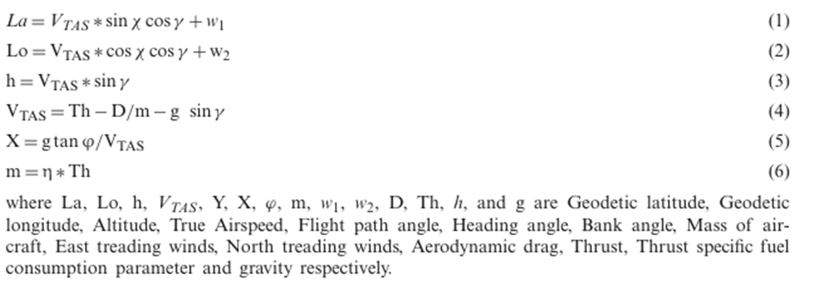
FLIGHT DYNAMICS
An aircraft needs to follow an Aircraft Dynamic Model (ADM). ADM enlists three degrees of freedom point mass model (PMM) with variable mass. PMM represents all the intricacies of an aircraft movement as shown in Equations. (1) – (6)

Slide 4
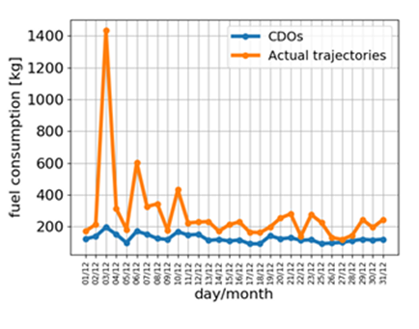
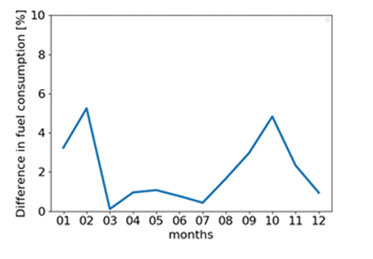
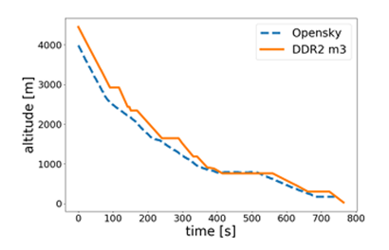
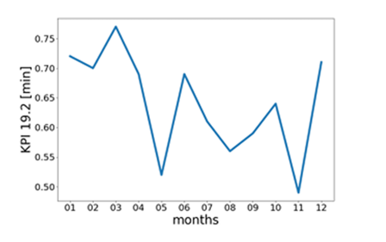
VFE INDICATORS AND KPIS CALCULATED FOR THE YEAR 2018 BY MONTHS:
COMPARISON OF AIRPORT VFE STATISTICS FOR 2017 AND 2018:

Slide 5
MATHEMATICAL MODEL FOR FUEL CONSUMPTION
Differential Equation and Derivation : This section delves into the technical aspects of the model. It probably introduces the differential equation(s) that form the basis of the model. The process of deriving these equations, presumably from physical laws or empirical observations related to fuel consumption, is also explained.
Fuel Efficiency Estimation Model: This model evaluates fuel consumption measured in liters per 100 km.
For our mathematical model to visualize the fuel consumption of a standard commercial aircraft, we took the Boeing Airbus A320. We took the drag coefficient for an altitude of approximately 10,000 m (about the cruising altitude of a commercial jet), the surface area of the plane as 122.6 m, and air density 0.366 kg/m³. From here, we considered the velocity as 230 m (about twice the
height of the Statue of Liberty)/s, and the mass of the aircraft as 72,000 tons.

Slide 6


DIFFERENTIAL EQUATION OF MASS OF FUEL CHANGING OVER TIME

Slide 7
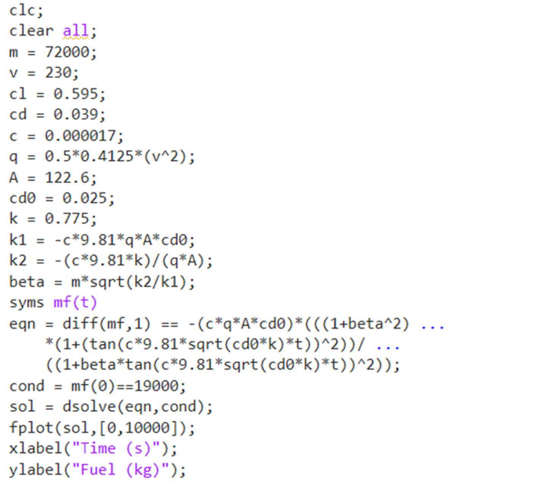
CODE

Slide 8
HTML
<!DOCTYPE html>
<html lang="en">
<head>
<meta charset="UTF-8">
<meta name="viewport" content="width=device-width, initial-scale=1.0">
<title>Flight Data Visualization</title>
<link rel="stylesheet" href="styles.css">
</head>
<body>
<div id="trajectory-chart"></div>
<div id="efficiency"></div>
<div id="emissions"></div>
<script src="script.js"></script>
</body>
</html>

Slide 9
JS
// Simulated data, replace this with data obtained from MATLAB
const flightData = {
trajectory: [ /* Array of trajectory points */ ],
efficiency: 0.85, // Example efficiency value
emissions: 120 // Example emission level
};
// Function to update the interface with flight data
function updateFlightData() {
// Update trajectory chart (using a chart library like Chart.js)
updateTrajectoryChart(flightData.trajectory);
// Update efficiency display
document.getElementById('efficiency').innerHTML = `Efficiency: ${flightData.efficiency}`;
// Update emissions display
document.getElementById('emissions').innerHTML = `Emissions: ${flightData.emissions}`;
}

Slide 10
JS - CONTD
// Function to update the trajectory chart
function updateTrajectoryChart(trajectoryData) {
// Implementation to update the trajectory chart using a library like Chart.js
// Example:
// var ctx = document.getElementById('trajectory-chart').getContext('2d');
// var myChart = new Chart(ctx, {
// type: 'line',
// data: {
// labels: /* Labels for x-axis */,
// datasets: [{
// label: 'Trajectory',
// data: trajectoryData,
// borderColor: 'blue',
// borderWidth: 1

Slide 11
JS - CONTD
// }]
// },
// options: {
// // Chart options
// }
// });
}
// Call the function to initially update the interface
updateFlightData();

Slide 12
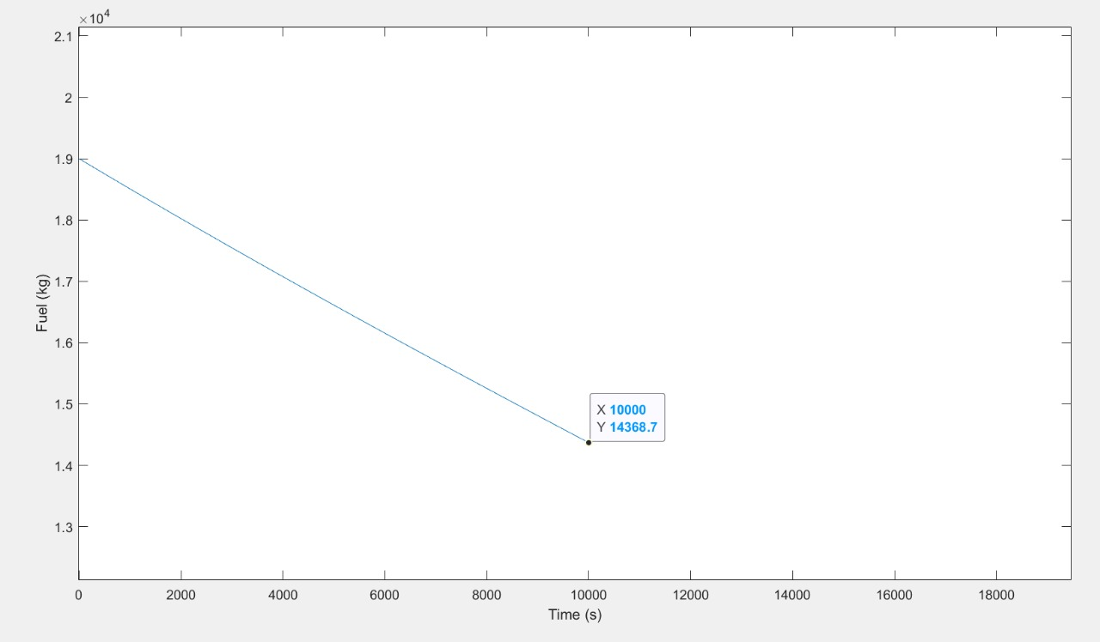
Mass 72 tons, speed 200m/s

Slide 13
Mass 72 tons, speed 200m/s

Slide 14
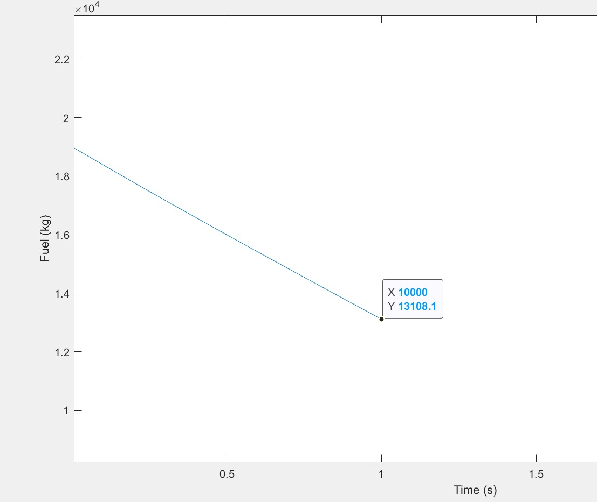
Mass 72 tons, speed 230m/s

Slide 15
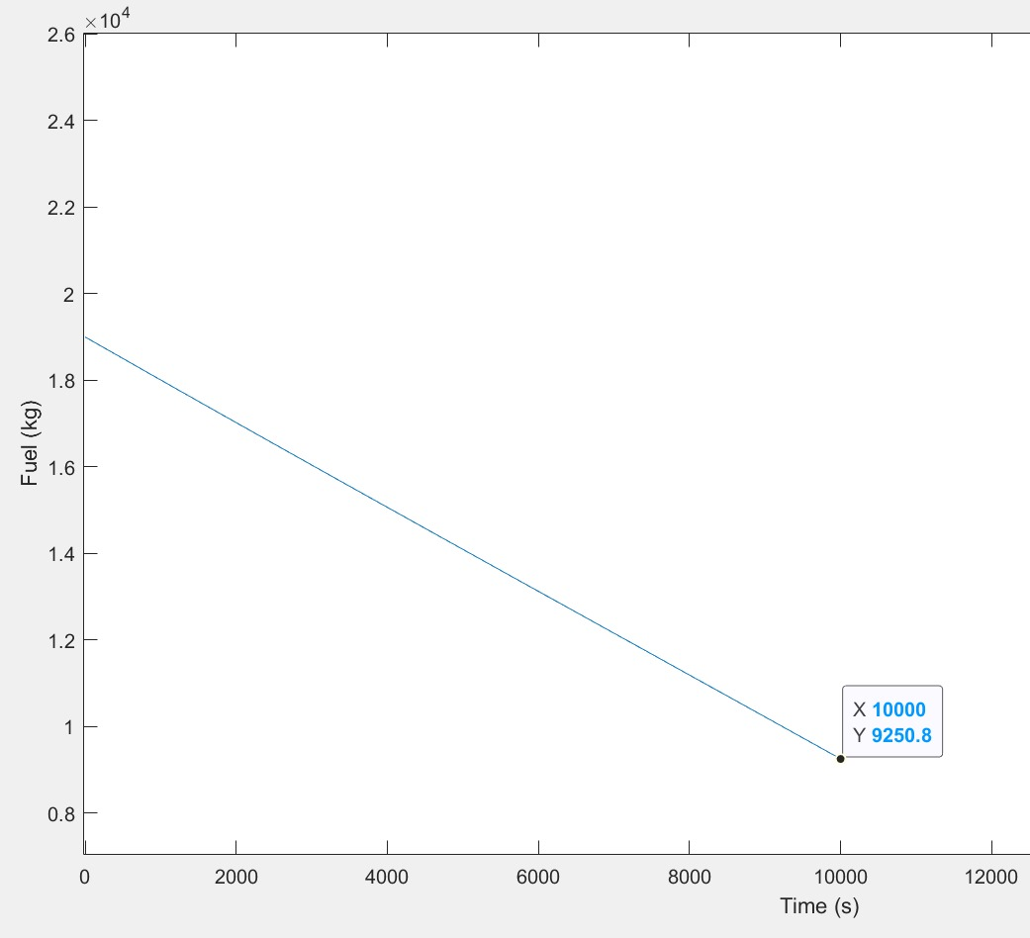
Mass 72 tons, speed 300m/s

Slide 16
FUTURE AIRCRAFT CONCEPTS
Aircraft Efficiency and Energy Consumption: This topic discusses how aircraft efficiency depends on factors like fuel burn, seating density, air cargo, and passenger load factor. Modern aircraft are approximately 80% more fuel-efficient than those of the 1960s.
Alternative Fuels and Aircraft Concept: Alternative fuels like Sustainable Aviation Fuel (SAF) and hydrogen are being explored for aviation. SAF is made from non-petroleum-based sources and can reduce fuel lifecycle carbon emissions up to 80%.
More Electric Aircraft (MEA) and Hydrogen as Fuels: MEAs are implemented to address global warming and make engines more fuel-efficient. Hydrogen, due to its high energy content and clean combustion, has emerged as a promising alternative to fossil fuels.
Exploring Other Alternative Energy Sources: Other alternative energy sources include wind power, hydroelectricity, solar power, biofuels, and hydrogen. These fuels have a small environmental impact and are sustainable.
Liquid Hydrogen: Challenges and Advantages: Liquid hydrogen has advantages like high gravimetric and volumetric hydrogen densities and hydrogen purity. However, its storage presents significant technical challenges due to its low density and high reactivity.

Slide 17
FUTURE AIRCRAFT CONCEPTS
Economic Considerations and Environmental Impact: Environmental protection contributes to economic growth9. However, there are challenges in balancing economic development goals with environmental conservation.
Comparative Studies and the Unique Contribution of This Study: Comparative studies can help identify weaknesses and shortcomings in existing processes and highlight effective practices that can be introduced to improve these processes.
Historical Perspective and Evolution of Aircraft: The evolution of aircraft has seen significant milestones from the first powered flight by the Wright Brothers to the contemporary aircraft so sophisticated they can’t be detected by radar or the human eye.
Comparative Analysis and Environmental Impact: Comparative analysis of the effect of economic policy uncertainty on environmental sustainability can provide critical insights into the link between economic policies and environmental sustainability.
Economic Considerations of Liquid Hydrogen: The adoption of hydrogen as a major energy carrier could greatly reduce greenhouse gas emissions and lead to more resilient and diversified energy systems.
Hydrogen vs. Kerosene: This topic would discuss the comparative benefits and drawbacks of using hydrogen and kerosene as fuels in aviation.
Conclusion and Future Directions: This would summarize the discussion and provide insights into the future trends and directions in the field of aviation.

Slide 18
PROBLEM OBJECTIVES
The project has 3 problem objectives:
Propose a mathematical model and algorithm for analysis, optimization, and dynamic planning of aircraft fuel consumption, emissions, and flight trajectories
Plot the graphs of a currently used differential equation for the fuel consumption of an aircraft
Identify future aircraft concepts and optimizations

Slide 19
MOTIVATION
In the contemporary landscape of aviation, the significance of aircraft efficiency has become increasingly pronounced, spurred by the escalating costs of jet fuel, and the crucial need for a more renewable mode of transportation.
Thus, our project aims to combat these effects, by researching a small fragment of the current state of aviation and determine how we can improve it. Our section in this project is the optimization of fuel consumption and the reduction of emissions.

Slide 20
RESULTS AND ANALYSIS
For the first problem objective we have identified the preferred data source for research due to its higher accuracy. The results of this work create a base for future research.
For the second problem objective, we have compared the rates of fuel consumption for multiple scenarios and plotted their respective graphs.
Lastly, for the last problem objective, we have compared our currently employed technologies with the prototypical and currently unfeasible technologies, assuming they have been improved, to conceptualize future aircraft.

Slide 21
INFERENCES
We have quantified the impact of the deviations from the flight plans in terms of fuel burn and calculated how much extra fuel is wasted due to vertical flight inefficiency. We have also theorized and identified possible ways this inefficiency can have a larger impact in the future.
We have begun to implement a method of determining the factors that most significantly affect fuel consumption, with an extremely large scope.
Finally, we have identified a promising aircraft concept that will use sustainable technologies such as liquid hydrogen fuel, for a more renewable future.

Slide 22
AIRCRAFT INNOVATION
Recent years have witnessed a comprehensive exploration of various aircraft concepts, encompassing diverse fuel types and even the integration of electricity. Among these alternatives, hydrogen stands out as the most conspicuous fuel type.
This innovative approach amalgamates the more electric concept with the utilization of liquid hydrogen, demonstrating superior efficiency, cost-effectiveness, and reduced environmental impact in comparison to traditional aircraft.
embracing forward-thinking concepts such as enhancing energy efficiency and mitigating harmful environmental effects is an unavoidable choice for shaping the future of aviation

Slide 23
AIRCRAFT EFFICIENCY
The nexus between the annual surge in air travel and the parallel increase in energy consumption and environmental impacts is undeniable
The imperative to address energy consumption is underscored by the significance of energy efficiency in aircraft across all modes of transportation
development of new, more fuel efficient aircraft and the modification of existing ones to adhere to sustainability goals

Slide 24
ALTERNATIVE FUELS
Depletion of fossil fuels in the coming decades necessitates a proactive approach in seeking alternative fuels for aviation
Crux of the matter lies in improving fuel efficiency by evolving aircraft systems and diversifying fuel types
Paramount goal is to reduce fuel consumption, a crucial aim for commercial aircraft
Advisory Council for Aeronautical Research in Europe (ACARE) was established with the ambitious aim of reducing fuel consumption and CO2 emissions by 75%, NOx emissions by 90%, and perceived noise by 65%

Slide 25
MORE ELECTRIC AIR
MEA system seeks to replace pneumatic, mechanical, and hydraulic systems with electrical ones, ushering in benefits that extend beyond traditional aircraft
Superior efficiency, lower fuel consumption, and reduced environmental impact
Boeing 787-8 Dreamliner stands as a prime example, with a 20% reduction in fuel consumption, lower CO2 emissions, and a smaller noise footprint

Slide 26
HYDROGEN AS FUEL
Most abundant element in nature, takes center stage as a formidable alternative fuel
Must be produced through methods like gasification and electrolysis
Liquid hydrogen (LH2) emerges as a particularly promising alternative
Necessitates ingenious technology and design, presenting a crucial challenge for future implementation

Slide 27
ALTERNATIVE ENERGY SOURCES
Solar-powered aircraft, fuel-cell-powered aircraft, and biofuels
Solar-powered aircraft face technological constraints for long-range flights
Fuel-cell technologies are currently limited to small aircraft with short ranges, but may be improved enough in the future to warrant an implementation
Adoption of biofuels faces challenges related to price differences and the requirement for blending with kerosene, decreasing renewability

Slide 28
LIQUID HYDROGEN
Studies like the Cryoplane project assess the feasibility of LH2 as a fuel for aircraft
Negative effects of LH2 tanks can be mitigated with longer transportation distances
Higher energy content per weight, increased efficiency for long-range transportation, and reduced direct operating costs
Lower energy content per volume, higher production costs, and storage challenges

Slide 29
ECONOMIC AND ENVIRONMENT
Cost of LH2, a critical factor in its viability, is contingent on the production method
Choice of production method significantly influences initial investment costs and operating costs
Reduction of CO2 emission rates in LH2 production is a consideration
Efficiency of LH2 is currently smaller for short and medium-range flights
Potential in long-range transportation is evident

Slide 30
UNIQUENESS OF STUDY
Holistic approach, aiming to identify the best future aircraft concept by suggesting changes to both fuel types and propulsion
ACARE performance criteria, H2O emissions, and fuel prices are considered concurrently, providing a comprehensive evaluation framework
Expands its evaluation beyond the cruise phase to include taxi operations
Offering a more nuanced understanding of energy efficiency and environmental effects

Slide 31
HISTORY
Sir George Cayley's fundamental concept of traditional airplanes, articulated in 1799
The Wright brothers, pioneers in aviation, not only built but successfully flew the first controlled aircraft in 1903
The first commercial flight in 1952 marked a transformative moment in aviation history
Traditional aircraft have been primarily powered by Kerosene; however, Kerosene combustion not only emits nitrogen oxides (NOx) and water vapor (H2O) but also releases carbon dioxide (CO2), contributing to the industry's environmental footprint

Slide 32
FUTURE DIRECTIONS
Highlighting the pressing need to address environmental challenges within the aviation industry
Comprehensive comparative analysis, encompassing traditional, More Electric Aircraft (MEA), and liquid hydrogen (LH2)-fueled aircraft, and incorporating ACARE performance criteria and environmental considerations, has yielded invaluable insights into the pursuit of sustainable aviation
Future aircraft concept, which integrates the more electric and liquid hydrogen-fueled paradigms, emerges as a promising trajectory

Slide 33
REFERENCES
_1) A Mathematical Model for the Analysis of Jet Engine Fuel Consumption during Aircraft Cruise
Francisco Velásquez-SanMartín, Xabier Insausti, Marta Zárraga-Rodríguez and Jesús GutiérrezGutiérrez
Energies | Free Full-Text | A Mathematical Model for the Analysis of Jet Engine Fuel Consumption during Aircraft Cruise (mdpi.com)
_2) Future aircraft concept in terms of energy efficiency and environmental factors Eren Baharozu, Gurkan Soykan, M. Baris Ozerdem
Future aircraft concept in terms of energy efficiency and environmental factors - ScienceDirect
_3) Evaluation of Flight Efficiency for Stockholm Arlanda Airport Arrivals Anastasia Lemetti, Tatiana Polishchuk
[PDF] Evaluation of Flight Efficiency for Stockholm Arlanda Airport Arrivals | Semantic Scholar

